Slide 1

Lexical Analysis
The First Phase of a Compiler
A Structured Approach to Compiler Design
Presented By: Nithya shree k [192521145]
B.Tech IT
2026

Slide 2
Introduction to Compiler
Translates high-level code to machine code
A compiler is a software tool that translates high-level programming languages (such as C, Java, and C++) into machine code that computers can execute directly.
Main Functions:
• Converts source code into machine code
• Detects programming errors during compilation
• Optimizes generated code for better performance
• Improves execution efficiency
Example: int a = 10; is compiled into machine language (binary).
Detects and reports errors
Optimizes for efficiency

Slide 3
Phases of
a Compiler
Lexical Analysis (First Phase)
Syntax & Semantic Analysis
A compiler transforms source code through multiple phases.
Each phase performs a specific task, passing its output to the next stage.
Lexical analysis serves as the foundation, preparing clean tokens for all subsequent processing.
Intermediate Code Generation
Code Optimization & Generation

Slide 4
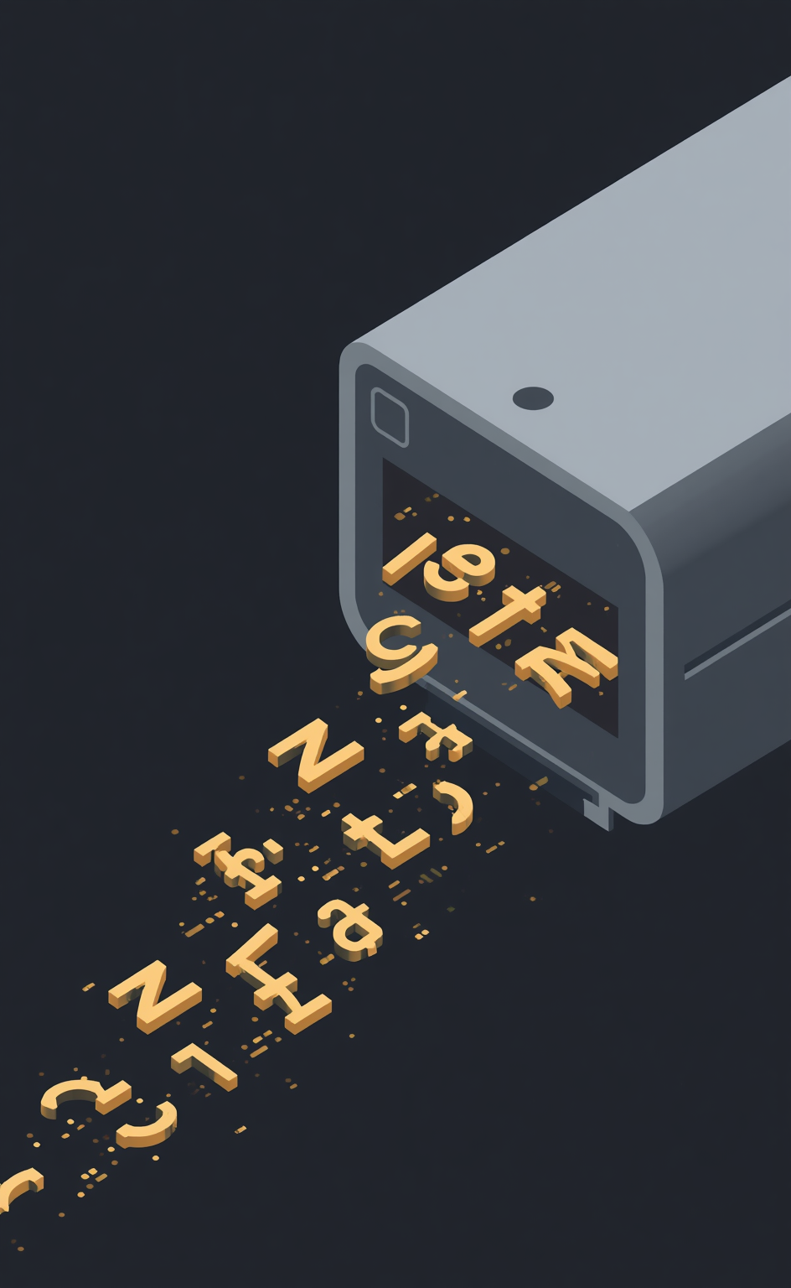


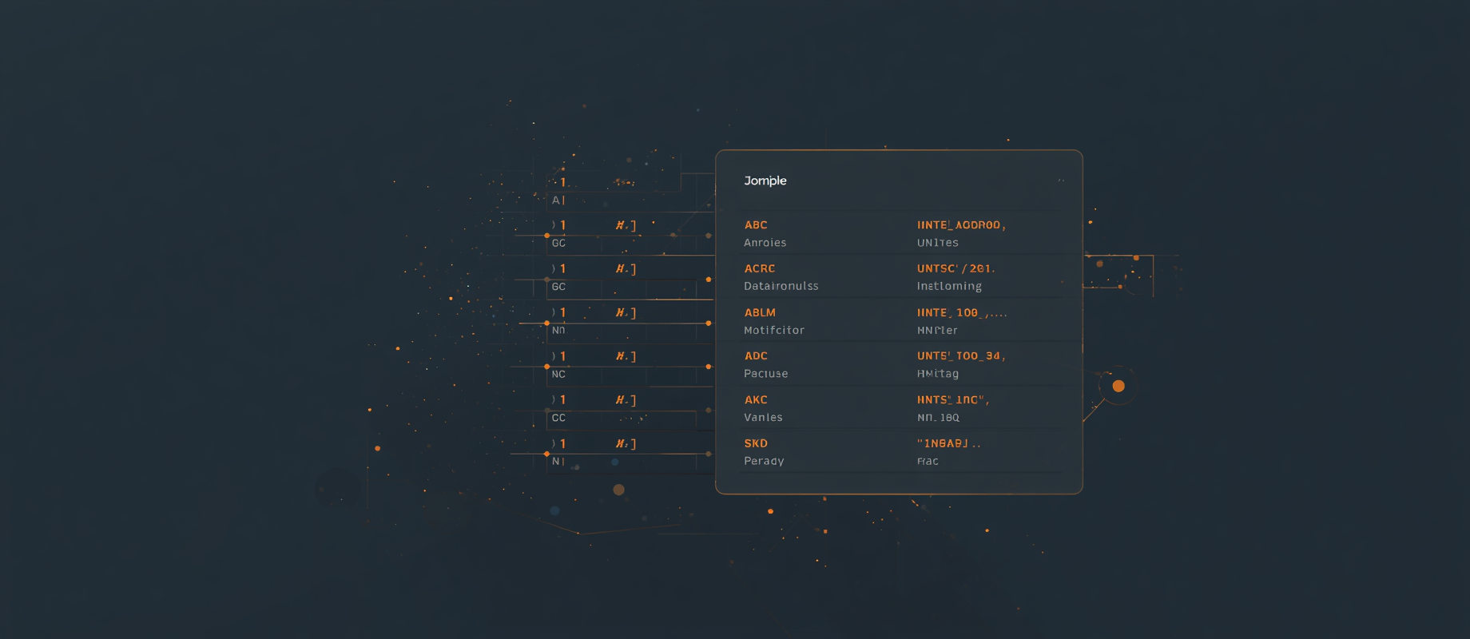

What is Lexical Analysis?
Read source code & remove spaces/comments
Identify tokens & detect lexical errors
Create symbol table entries

Slide 5
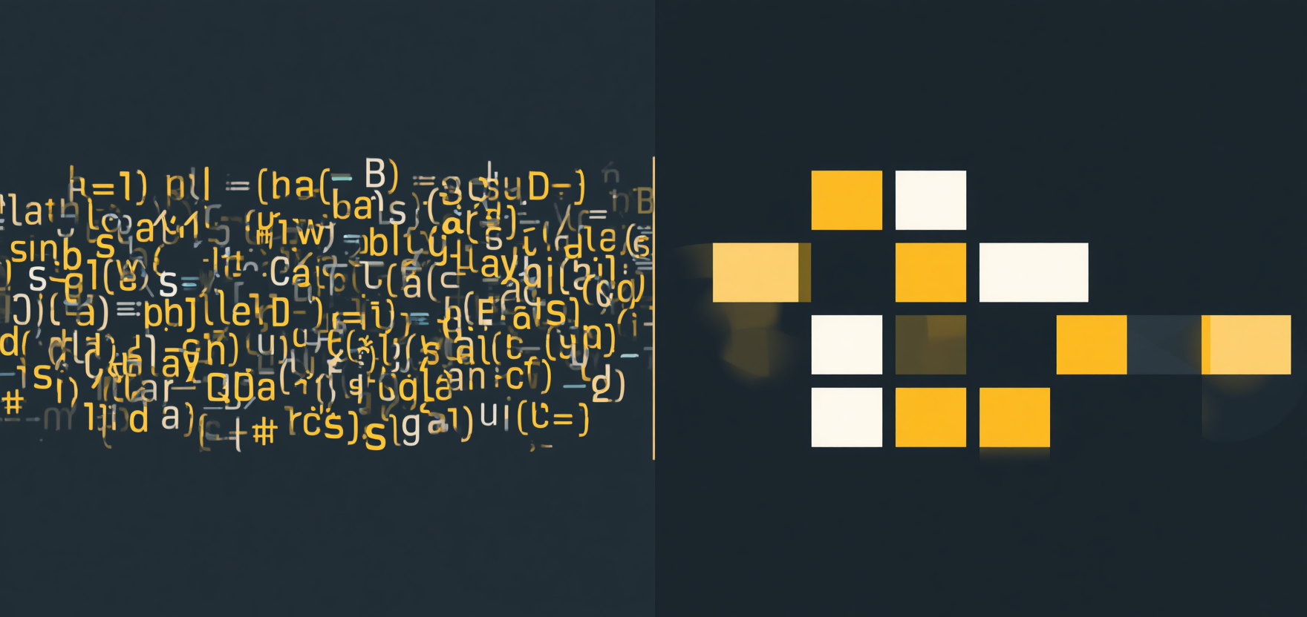
Why is Lexical Analysis Needed?
Without lexical analysis, the compiler receives a raw character stream like "inta=10;" and cannot distinguish where one word ends and another begins.
With lexical analysis, source code is split into meaningful tokens: int, a, =, 10, ;. This tokenization simplifies the work for all subsequent compiler phases, enabling accurate parsing and error detection.
Without
Lexical Analysis
With
Lexical Analysis

Slide 6




Input and Output of Lexical Analyzer
The lexical analyzer reads source code character by character and groups them into meaningful tokens. This page demonstrates how a simple source code statement is transformed into a structured token stream that subsequent compiler phases can process efficiently.
Input
int total = 100;
Output
Token Stream
Lexeme → Token
int → Keyword
100 → Number
; → Delimiter

Slide 7
Keywords (int, float, if)
Types of Tokens
Identifiers (total, count)
Tokens are the fundamental building blocks recognized by the lexical analyzer.
Each token type serves a specific purpose in programming language syntax, enabling the compiler to understand and process source code correctly.
Operators (+, -, =)
Delimiters & Constants (;, 100, "Hello")

Slide 8

Lexical Errors and Symbol Table
Lexical
errors
Symbol table
Lexical errors occur when the scanner encounters invalid patterns: identifiers starting with digits like "123abc" or unrecognized symbols like "@".
These break tokenization rules and must be caught early.
The symbol table stores all identifiers with their data types for fast lookup and scope management during compilation.

Slide 9
Real-Life Example of Tokenization
float → Keyword
salary → Identifier
Input: float salary = 25000;
Output: Token stream with each lexeme mapped to its token type. This step-by-step breakdown shows how the lexical analyzer processes source code character by character, grouping them into meaningful tokens for the compiler.
= → Operator
25000 → Number, ; → Delimiter

Slide 10
Advantages
Applications
Compiler design
Programming language development
Modern code editors
Syntax highlighting engines
Static code analysis tools
Integrated development environments (IDEs)
Lexical analysis is the first phase of a compiler.
It transforms raw source code into a structured token stream.
This process enables faster compilation by detecting invalid words early.
Lexical analysis involves removing comments and whitespace.
It creates clean token sequences for subsequent phases.

Slide 11
Thank you
for your attention!

